Slide 1


Quality Improvement Business Review
Achieving Last To Clear Reduction Using Shipment Movement Scan Time

Slide 2



AGENDA
Executive Summary
Opportunity Statement
Team Engagement
QAT Charter
Assess
Build
Launch
Evaluate
Cost Savings

Slide 3

Executive Summary
Improving our customers’ experience by reducing damaged deliveries, highlighting opportunities with Last to Clear data
Opportunity for the QAT
Last to Clear “Fish Finder” damaged delivery exception data was used to determine root causes at the top exception-charged locations
Root Cause Analysis Used
We utilized time-specific data to isolate opportunities and partnered with operations teams to adjust freight handling practices
Solution Developed and Implemented
After 90 days, the SOEA has seen a 42.2% improvement in Last to Clear charge reduction during peak exception time periods

Slide 4
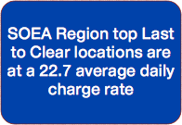
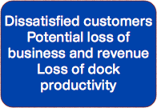
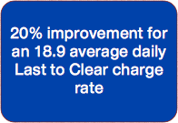
Opportunity Statement
Identify peak times when freight damage occurs, in order to couple work method coaching with operational adjustments to reduce overall damaged delivery exceptions
Current State
Impact of Problem
Desired State

Slide 5

Team Engagement: Subject Matter Experts
Mike Benzy:
Data Interpretation
Excel
Sean Pierce &
Brian Kruzan
Work Methods
Ross Holcomb &
Mike Jones:
QDM Principles
Michelle Blake &
Dawn Cox:
Dock Education

Slide 6
QAT Charter
Business Reason: This project supports the FedEx Customer Loyalty Initiative as well as the Chairman’s Loss and Damage Reduction challenge. | Opportunity Statement: Identify peak times when freight damage occurs, in order to couple work method coaching with operational adjustments to reduce overall damaged delivery exceptions Current State: SOEA Region top LTC locations are at a 22.7 average daily LTC charge rate Impact of Problem: Dissatisfied customers, Potential loss of business and revenue, Loss of dock productivity Desired State: 20% improvement for an 18.9 average daily Last to Clear charge rate
Project Scope: At point of shipment pick up to point of shipment delivery | Team Roster: Sponsor: Chris Reynolds Facilitators: Ross Holcomb, Mike Benzy, Michael Jones Team Members (with employee numbers): Ross Holcomb: Michael Jones: Mike Benzy: Michelle Blake: Dawn Cox: Brian Kruzan: Sean Pierce:
Project Plan:
Phase Start Date End Date
1455594
2093376
1456756
1512790
1513058
1611970
1456862
Assess
Build
Launch
Evaluate
11/01/2013
11/11/2013
11/18/2013
12/09/2013
11/08/2013
11/15/2013
12/07/2013
02/15/2014

Slide 7
Assess: Understanding the Customer Experience
Last to Clear:
A term used for a delivery exception reporting system designed to identify the last location/employee to load or unload a shipment free of exception (over/short /damaged)
Shipment arrives at origin center “ABC”
Supervisor closes trailer for dispatch
Trailer dispatched and arrives to Customer location
Driver calls into center to report exception
Employee unloads shipment.
Clear of exception?
Employee loads shipment onto delivery trailer
Customer signs delivery receipt.
Clear of exception?
Employee enters delivery exception into ACCOPS to record exception
Yes or No
No
Employee enters notation into dock cpu to record exception
Yes
Yes
Employee loads shipment onto outbound trailer
No
Yes or No
Yes or No
No
Purple Promise not provided to Customer with exception-free delivery.
Potential claim to be filed.
Yes
Supervisor closes trailer for dispatch
Trailer is dispatched and arrives at destination “XYZ”
Employee unloads shipment.
Clear of exception?
Purple Promise provided to Customer with exception-free delivery

Slide 8
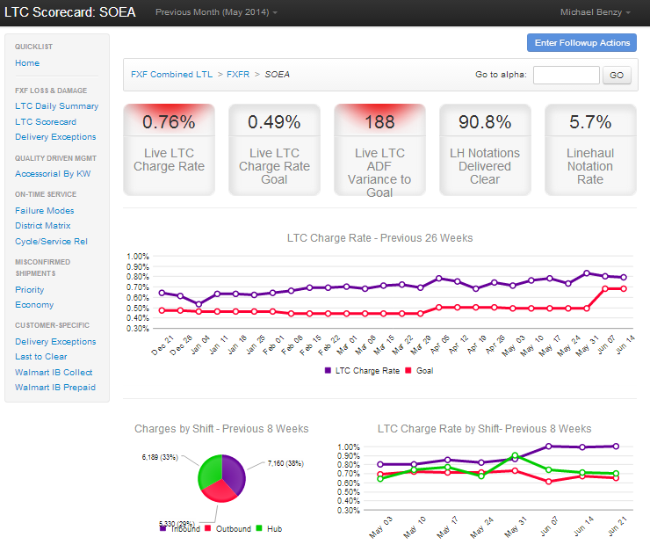

Assess: Current Common Process
The LTC Scorecard is the current tool used to attempt to reduce damaged delivery exceptions:
No center pro-level detail
Exception detail for top charged employees, not an entire center
No time stamp
No way to tell when our exceptions are happening
Broad approach
Graphs show trends over time, but do not highlight actual opportunities

Slide 9
Assess: Desired Common Process
A tool is needed that gives us more precise information than the current LTC Scorecard:
?
Control over pro-level detail
Allow data manipulation of exception detail for the Service Center, District, & Regional level
Time stamp detail
Ability to identify when most charges are happening to isolate problem times to maximize effectiveness
Narrow approach
Graphs that give a clear visual as to exactly when certain events need the most attention

Slide 10
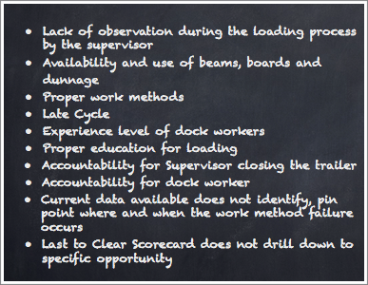
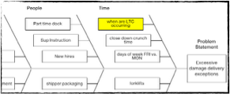


Build: Root Cause Analysis
Methods utilized to assist us in determining root causes:
Fishbone diagram
Group brainstorming
Through our root cause and
multi-voting, “time” was identified

Slide 11
Build: Desired Common Process
Develop an alternative
The LTC Scorecard in its’ present form gives broad-scale direction to operations leadership. However, it does not narrow visibility into the data to address the root cause.
Streamline data
Highlight spikes in time-specific graphs so analyst time is spent more wisely.
Create consistent approach
Job aid documents to be written as a guide for teams to follow so the approaches remain consistent.
Work identified locations
Observe work method and freight handling practices during the peak exception times to determine where education opportunities occur.
Partner with Leadership
Share outcome of observations and education opportunities with local Leadership to improve the coaching quality of our front line Supervisors with their hourly employees.

Slide 12
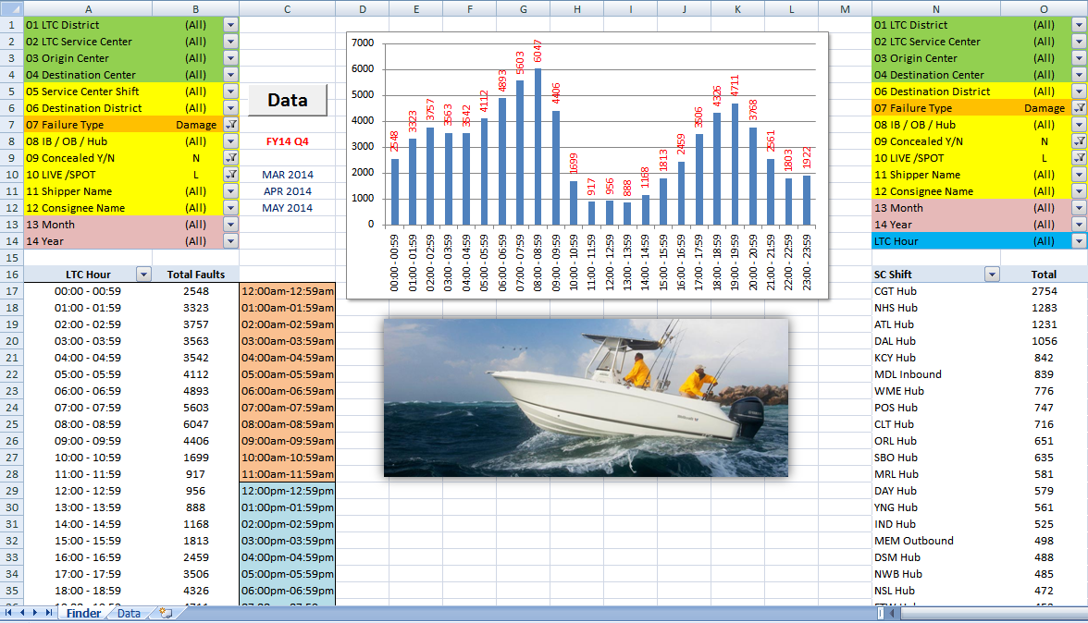
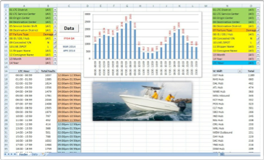
Build: Fish Finder LTC Data by Hour
Multiple filters to streamline data to show exactly what is desired
Filtered data is presented in graph form to visually see totals by hour
Totals by hour are able to be converted to pro-level detail and exported
Service Center totals are listed, highlighting top opportunity locations based on filtered data
The Fish Finder report gives us precise data in a visual format not possible with the LTC Scorecard

Slide 13
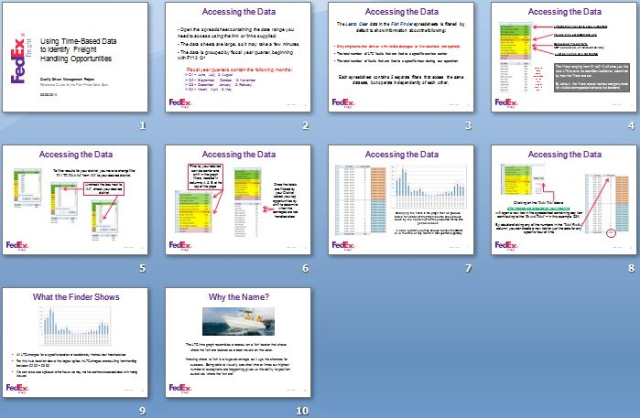

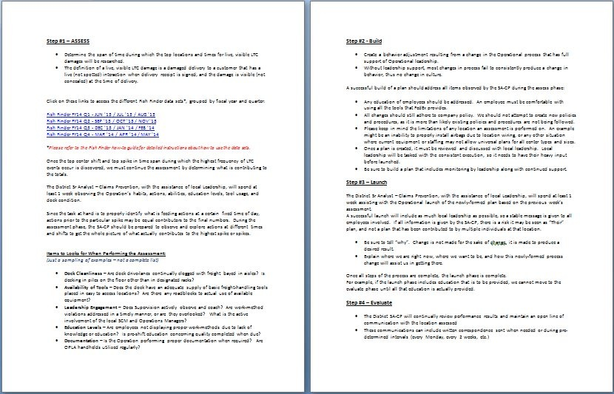
Launch: Job Aides
Data Access Job Aid
Instructional Process
Job Aid

Slide 14
Launch: Solution
Sr Analysts-Claims Prevention...
will utilize the Fish Finder tool and job aids to highlight areas with the largest opportunity by location, shift, and the time of day
Define...
top peak times by when most LTC charged exception shipments are handled using a time-specific drilled-down approach.
Reduce...
top location Last to Clear charge rates through work method coaching and education.
Local Operations teams...
will meet with the Sr Analyst-Claims Prevention at each target location to review data, suggest a different approach, & ask for support and assistance.
Operations Leadership teams should include (when applicable):
MD of Operations, Manager-Service Center, Assistant Manager-Service Center, Operations Manager, Operations Supervisor

Slide 15
Launch: Improvement Measurement
LTC Exception Goal: Last to Clear charges per day in target peak times
will be used to measure success
AT
CL
ME
NA
OR
SOEA
ATL
CLT
MEM
NAS
ORL
01:00-04:00
00:01-04:00
19:00-22:00
01:00-04:00
00:01-04:00
BASELINE
AUG-OCT
DISTRICT
PEAK-TIME TARGET
4.5
5.8
3.6
3.6
5.2
22.7
3.7
4.9
3.0
3.0
4.3
18.9
LOCATION
GOAL
(20% REDUCTION)

Slide 16
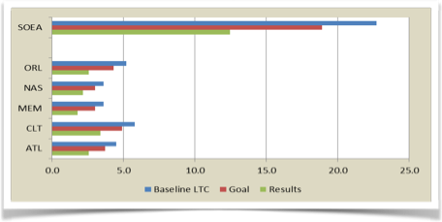
Evaluate: Results Reporting - Average LTC Charges per Day
SC
Baseline LTC
Goal
Results
Improvement
ATL
CLT
MEM
NAS
ORL
SOEA
4.5
5.8
3.6
3.6
5.2
22.7
3.7
4.9
3.0
3.0
4.3
12.5
2.6
3.4
1.8
2.2
2.6
12.5
39.6%
39.6%
47.5%
33.8%
49.0%
42.2%

Slide 17
Evaluate: Results Reporting - Average LTC Charges per Day
SC
Baseline LTC
Results
Improvement
Level
Baseline LTC
Results
Improvement
DEFINED PEAK TIMES
ATL
CLT
MEM
NAS
ORL
4.5
5.8
3.6
3.6
5.2
2.6
3.4
1.8
2.2
2.6
39.6%
39.6%
47.5%
33.8%
49.0%
AT
CL
ME
NA
OR
47.9
54.2
44.4
37.3
55.4
37.6
39.2
34.6
30.1
39.2
21.4%
27.7%
22.1%
19.5%
29.2%
DISTRICT
SOEA
22.7
12.5
42.2%
SOEA
MIWE
NOEA
NOWE
SOWE
239.1
277.6
216.0
187.6
173.4
180.7
216.1
163.8
140.4
129.8
24.4%
22.1%
24.2%
25.1%
25.2%
REGION
The defined peak time daily LTC charges at each location improved at a greater rate compared to the district, region and company level during the launch and evaluate stages.
FXFR
1107.6
842.4
23.9%

Slide 18





Evaluate: Results Reporting
Reporting outline for SOEA LTC reduction (13 weeks post launch):
Process to Measure
Actual Results
Expected Results
LTC failures charged per day during defined peak time periods
Review Date
SOEA LTC charges per day improved by 42.2% or a 12.5 LTC charges per day
All-up LTC charges per day improvement in the SOEA Region by 20%
(22.7 to 18.9)
02/15/2014

Slide 19

Cost Savings
During our Assess period (AUG, SEP, OCT 2013):
Based on our 42.2% improvement:
35,875 claims filed
26,785 claims paid
If each center employed the same educational focus through all facets of their operation, this has the potential to improve baseline-period data by 11,303 claims paid, which would be a potential quarterly dollar savings of
= $608.46 paid per claim
$16,297,496.14 total paid
$6,877,587.66
28.30% of all LTC charges ended with a claim filed
21.13% of all LTC charges equates to a claim paid

